Slide 1


CREDIT CARD DATA ANALYSIS
PROJECT
“Unveiling Credit Card data: Trends, Usage
and Insights”
Presented by
Sayan_M

Slide 2

CONTENT
01
ABOUT
02
PROJECT OBJECTIVE
03
DATA UNDERSTANDING
04
SET UP DATABASE & IMPORT DATA
05
DATA CLEANING & TRANSFORMATION
06
BUILDING DASHBOARDS
07
INSIGHTS

Slide 3

ABOUT
This Credit Card Analysis Project using Power BI and PostgreSQL, focuses on providing comprehensive insights into the credit card transactions and customer behavior. This report analyzes transaction trends, customer spending patterns, and demographic insights to optimize marketing strategies and improve customer satisfaction and overall business performance.

Slide 4



PROJECT OBJECTIVE
To develop a comprehensive credit card weekly dashboard that provides real-time insights into key performance metrics and trends, enabling stakeholders to monitor
and analyze credit card operations effectively. This project aims to analyze weekly credit card transaction data coupled with customer information to achieve the following objectives:

Slide 5
Measure KPI’s
To measure and analyze various aspects of credit card data such as Revenue generated, transaction volume, Total Interest earned, Customer Satisfaction score . By monitoring these KPIs, businesses can assess their performance. And also segment analysis by quarters, weeks, and months to uncover revenue trends.
2. Week-on-Week Comparison
Perform week-on-week revenue comparisons to identify trends, anomalies, and deviations from expected revenue patterns. So that, businesses can detect seasonal trends, promotional effects, and emerging market dynamics.
3. Customer Spending Habits
Explore customer spending behaviors and preferences across different card categories and expenditure types to gain insights into customer demographics, purchasing preferences, and spending patterns.
4. Customer Demographics
Analyze Revenue based on different customer information metrics such as Educational level, Customer Job type, State, Income group, personal loan status .. to gain insights into customer demographics

Slide 6
DATA UNDERSTANDING
Source : Kaggle
Datasets : 2
File type : .csv
Details : Credit card Transaction and Customer information
Data span : Jan 2023 - Dec 2023
Records : 10,293

Slide 7



SET UP DATABASE
&
IMPORT DATA

Slide 8

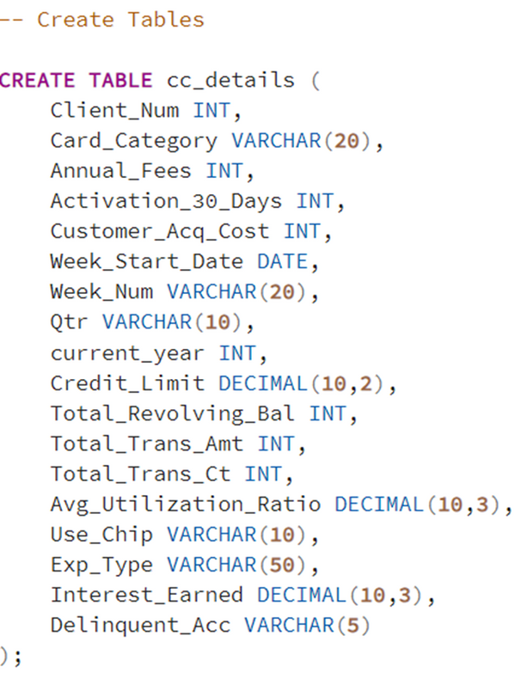
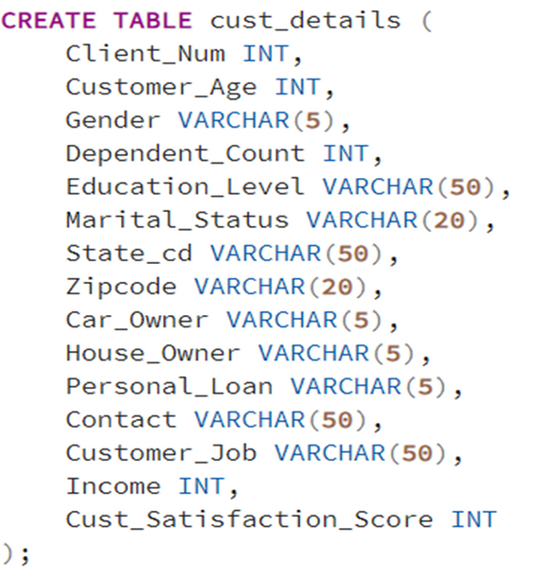
Crafting a data repository within the framework of PostgreSQL and building tables for both Credit Card Transaction and Customer Information data within the database.

Slide 9
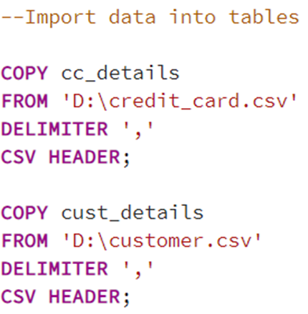
Bringing raw csv data into the PostgreSQL database by slotting it into the tables that have created.

Slide 10


CONNECTING DB WITH POWER BI
Linking PostgreSQL database directly to Power BI in order to easily visualize and analyze the data in real-time.

Slide 11

DATA CLEANING
&
TRANSFORMATION

Slide 12

No missing values or inconsistencies were detected ensuring reliability and accuracy in the dataset.
DATA CLEANING :
Using DAX queries data is aggregated and transformed to calculate important metrics and KPI’s such as Total revenue, Average utilization ratio, Customer Acquisition cost...
DATA TRANSFORMATION :
Introducing a comprehensive metric named Revenue, which helps in keeping an overview of the financial performance.

Slide 13
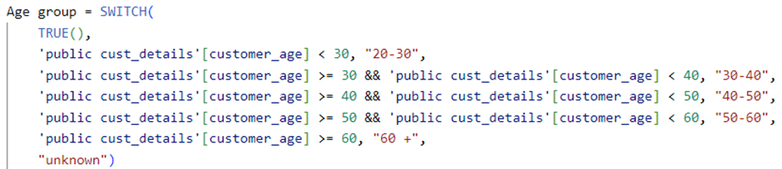

Introducing a new column, ‘Age group’, designed to categorize customers into age buckets using ‘SWITCH’ function.
Introducing the ‘Income group‘ column, used to categorize customers based on their income levels using ‘SWITCH’ function that helps in analysis.

Slide 14



Created DAX queries to measure the total revenue generated within the current week and also within the previous week using CALCULATE function in order to find the Week-on-Week change in revenue.

Slide 15

Created a new metric, Average Utilization ratio(AU Ratio) which refers to the average percentage of credit card limits that are being used by cardholders.
Created a new measure Delinquency Rate, which refers to an account on which the cardholder has failed to make the minimum required payment by the due date.

Slide 16
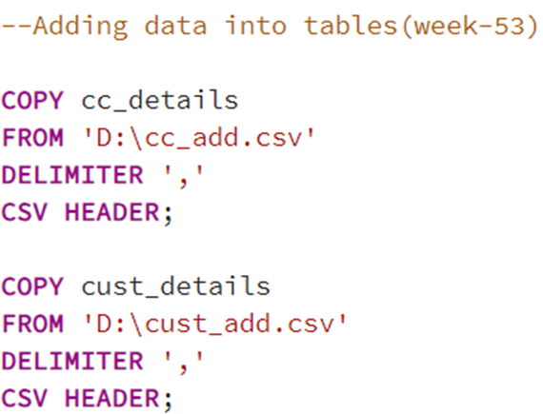
UPDATED WEEKLY DATA IN SQL DB
Integrated the new week's (week-53) financial and customer data into the PostgreSQL database ensuring the analytics reflect the most current trends and patterns.

Slide 17

BUILDING DASHBOARDS

Slide 18
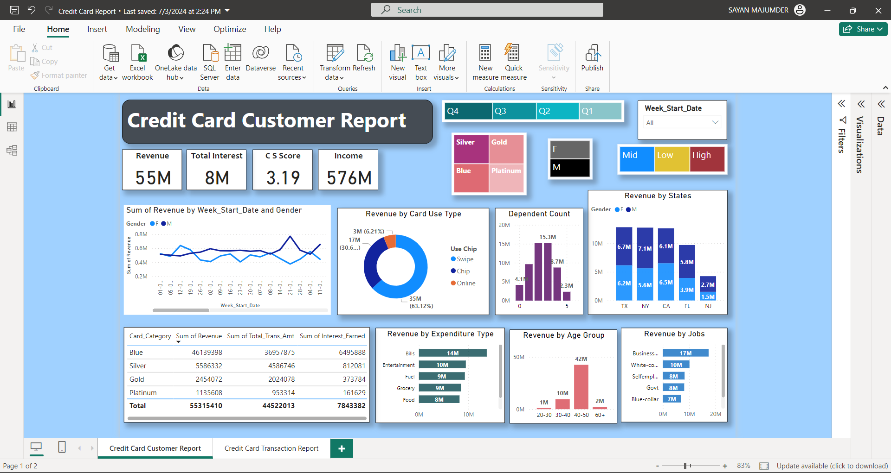

Slide 19
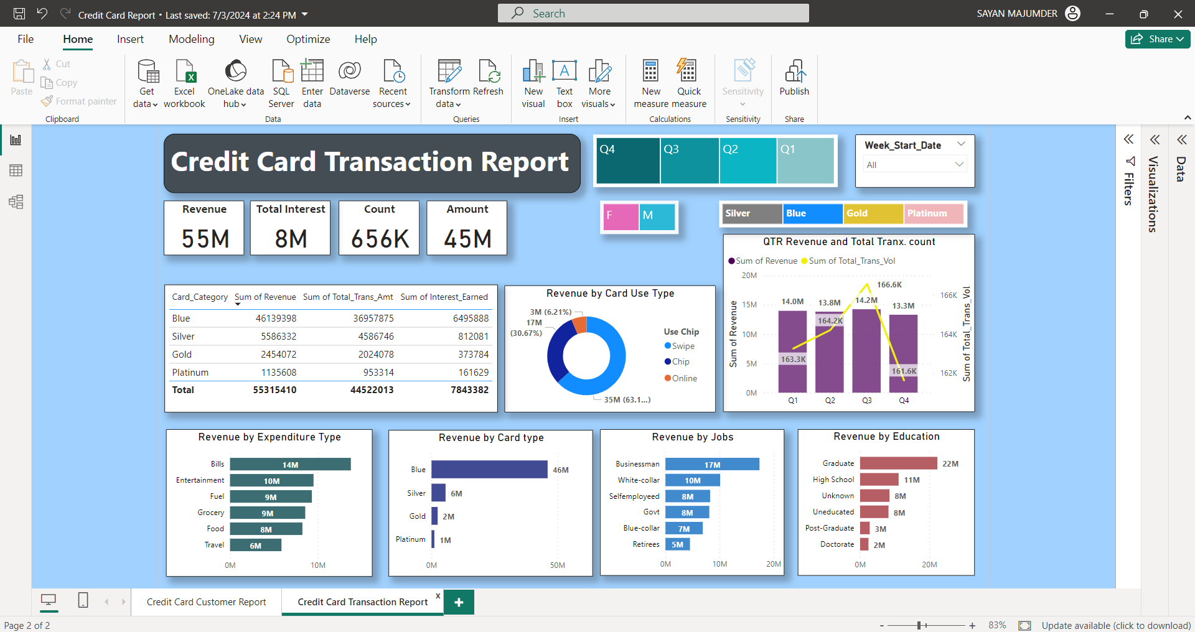

Slide 20
Dashboard 1: CREDIT CARD TRANSACTION REPORT
Key Features :
KPI Monitoring
Tracks essential KPIs related to credit card usage and financial performance.
Revenue Analysis by Timeframe
Quarterly, monthly, and weekly revenue breakdowns for detailed trend analysis.
Revenue Analysis by Age Group & Expenditure Type
Segmentation of revenue based on Age groups for targeted insights and by expenditure type, allows understanding of spending habits and preferences.
Revenue Analysis by Card Attributes
Breakdown of revenue by card category and card use type to understand usage patterns.
Interactive Filters
Weekly date filters, card category filters, gender filters etc,. for customized analysis.

Slide 21
Dashboard 2: CREDIT CARD CUSTOMER REPORT
Key Features :
WoW Revenue Growth
Provides a comparative analysis of revenue changes on a weekly basis, allowing for trend identification and forecasting.
Demographic Impact Analysis
Analyzes the impact of revenue on customer demographics based on gender, including educational level, job type, marital status, and income group, facilitating targeted marketing strategies.
Top 5 States Contribution
Identifies the top five states contributing to overall revenue, enabling focused marketing efforts and regional strategy development.
Tree Maps
Utilizes tree maps for visual representation of data, aiding in the intuitive interpretation of revenue distribution across different categories and demographics.

Slide 22

INSIGHTS

Slide 23
Week-on-Week Insights:
Revenue Growth: The company's revenue increased by 28.8% compared to the previous week.
Customer Growth: The number of active customers has increased by 12.80% compared to the previous week.
Transaction Count and Transaction Amount for the current week increased by 3.39% & 35% respectively compared to the previous week.

Slide 24
Overview YTD :
Overall Revenue : The total revenue generated from credit card transactions for the analyzed period is $57 million.
Cost-to-Revenue Ratio: The customer acquisition cost represents approximately 1.74% of the total revenue generated.This cost reflects the investment made by the company to attract new customers.
Overall Activation Rate: The overall activation rate is 57.5%, indicating the proportion of issued credit cards that have been activated by customers.

Slide 25
Overall Delinquency Rate: The overall delinquency rate for the credit card portfolio is 6.06% indicating that, on average, approximately 6 out of every 100 accounts have payments that are past due.
Average Utilization Ratio: The average utilization ratio for the credit card portfolio was approximately 13.47% which provides insights into how much of the available credit customers are using on average.
Average Customer Satisfaction Score: The average customer satisfaction score for the credit card company is 3.19 out of 5 indicates a moderate level of satisfaction among customers, reflecting their overall perception of the services and products offered by the company.

Slide 26
Customer Spending Patterns :
Spending Categories: Analysis of spending patterns shows that customers primarily use their credit cards for essential expenses such as bill payments (24.7%), entertainment (17.3%), and fuel (16.9%).
Credit Card Contribution: A significant portion of the total transaction volume is driven by the Blue and Silver credit cards, collectively about 93% of the overall transactions, underscoring their popularity and high usage among customers.
Transaction Method: The swipe method remains the most popular choice among customers, accounting for 66.9% of all transactions. This indicates a preference for convenience and speed in completing transactions.

Slide 27
Customer Demographics :
Revenue Contribution by Gender : Male customers
are the leading contributors to the total transaction revenue about 54.4% ($31M) and female customers contributed 45.6% ($26M).
Customer Age Group : Customers aged 40 to 50 contribute the highest revenue which is about 43.7% ($25M). This age group typically has higher spending capacity and engages in a variety of transactions, including higher-value purchases.
Top 3 States Contribution: The analysis of credit card transactions reveals that the top three states, Texas (TX), New York (NY), and California (CA), collectively account for a significant portion which is about 68% of the total transaction amount.

Slide 28
Educational Level: Customers with a graduate degree have a higher propensity to spend and contribute significantly to the credit card company's revenue (40.3%).This demographic typically has higher income levels and spending capacity.
Job Type: Businessmen, characterized by their professional status and likely higher income, contribute a substantial portion of the total revenue (31.3%). Their spending patterns may include business-related expenses and high-value transactions.
Income Level: Customers with high income levels have a greater ability to spend on credit cards, contributing nearly half of the total revenue (49%). They may engage in luxury spending, travel, and other high-ticket purchases.

Slide 29
Marital Status: Married customers contribute the highest revenue (50.6%), suggesting stable financial situations and potentially higher household spending.
Personal Loan Status: Customers who do not have a personal loan contribute the most revenue for the credit card company, accounting for 87.42% of total revenue indicates that customers without personal loans may rely more on credit cards for various expenses, leading to higher transaction volumes and revenue generation.

